Slide 1

Muhahmmed Rabeeh 7-04-2022
CRYPTOCURRENCY PROJECT

Slide 2

Introduction
In this project we perform the following tasks :
Calculating the quantum of the bitcoin
Plotting Ethereum’s ‘High’ for first 15 and last 10 days.
Plotting rolling average of volume
Plotting marketcap of all coins
Plotting candlestick chart for all the coins
Building a scatter plot for ETH and BTC for years

Slide 3
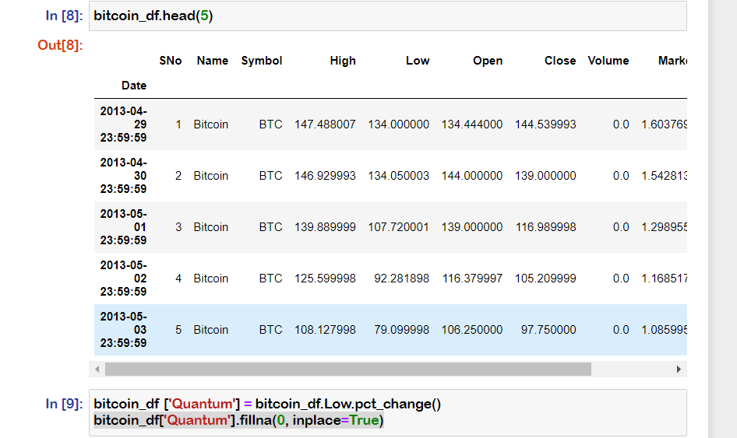
Calculating the quantum of the bitcoin

Slide 4
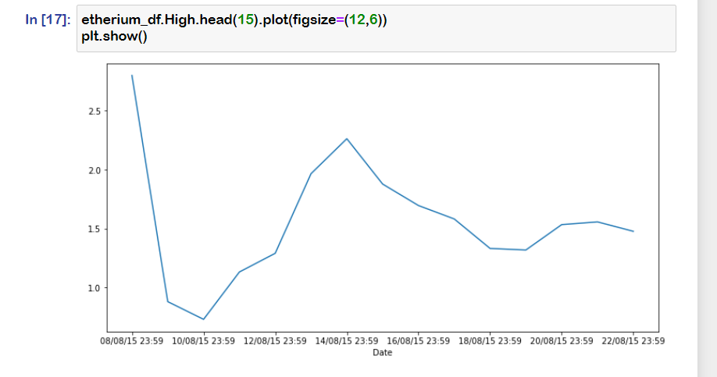
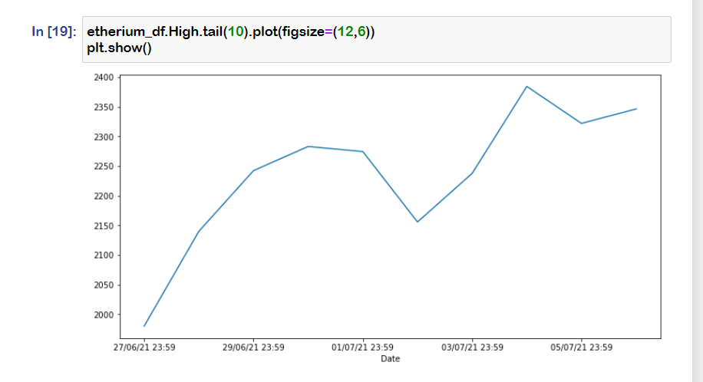
Plotting Ethereum’s High for first 15 and last 10 days

Slide 5
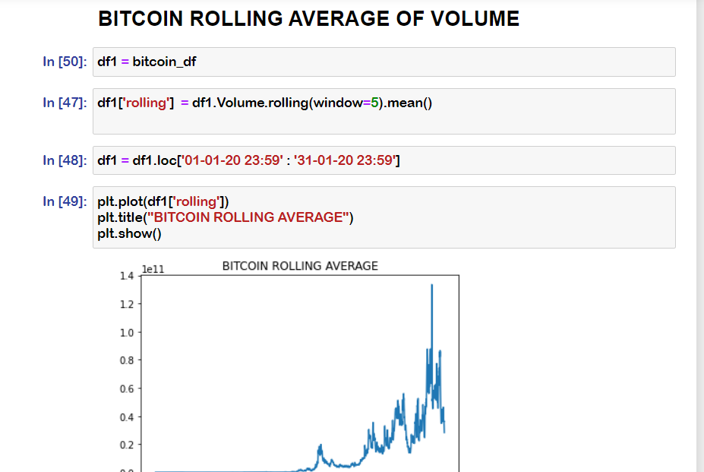
Plotting rolling average of volume of Bitcoin

Slide 6
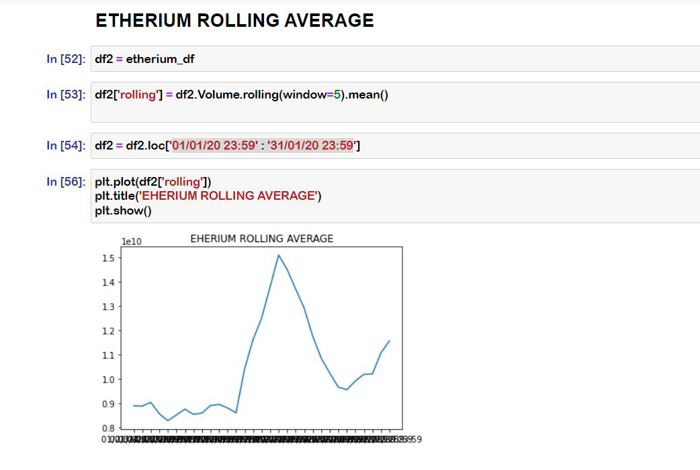
Plotting rolling average of volume of Etherium

Slide 7
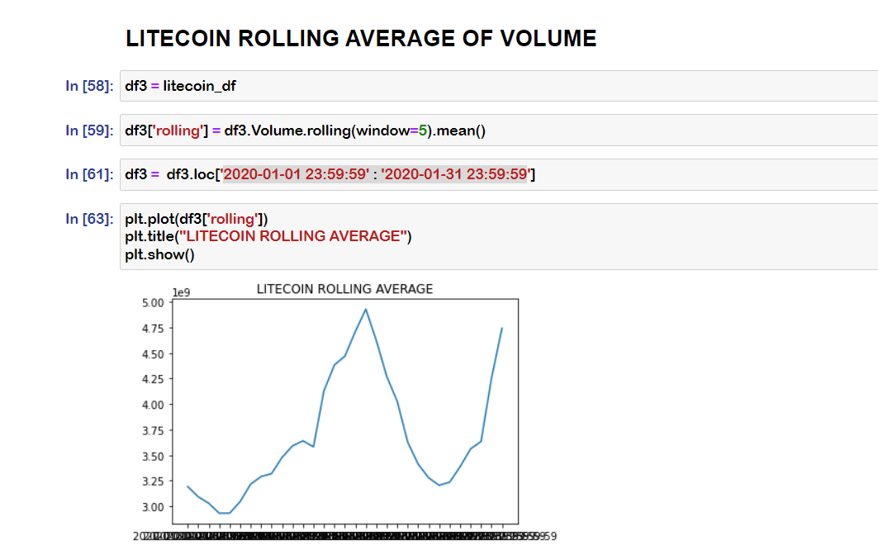
Plotting rolling average of volume of Litecoin

Slide 8
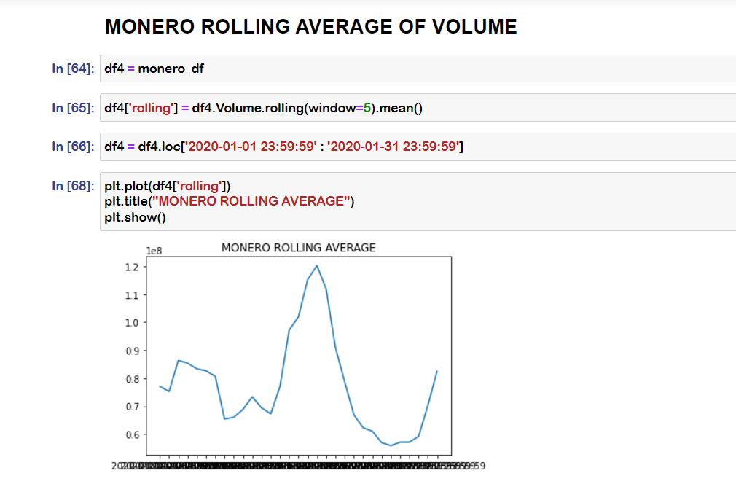
Plotting rolling average of volume of Monero

Slide 9
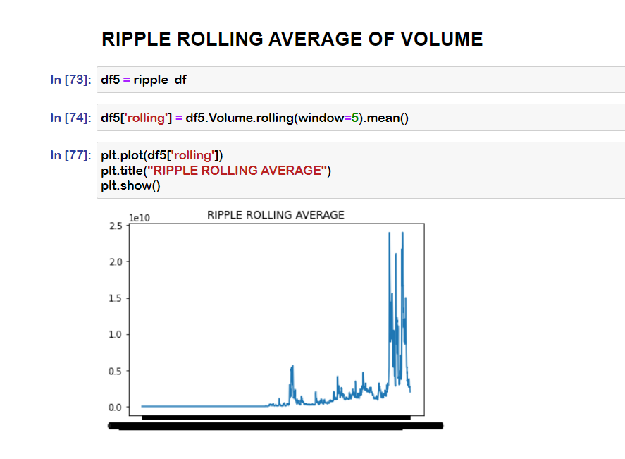
Plotting rolling average of volume of Ripple

Slide 10
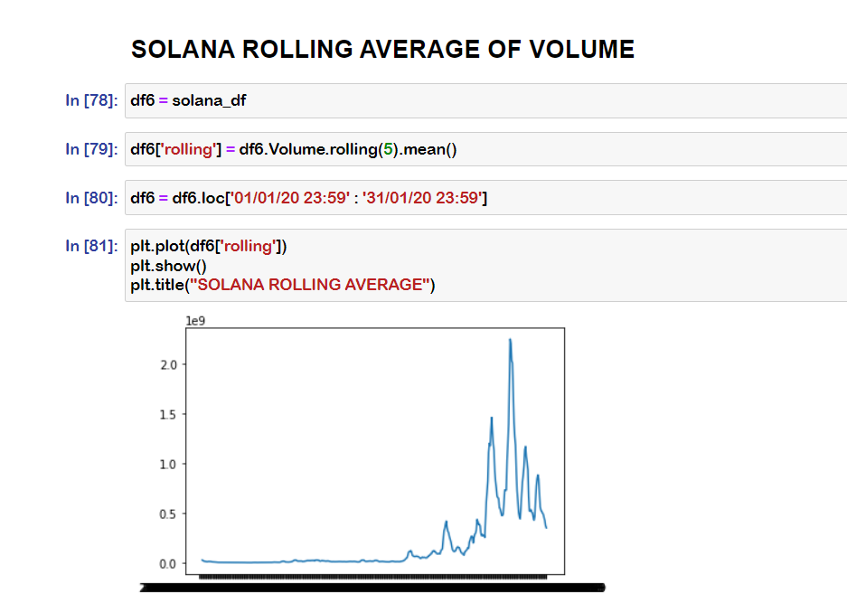
Plotting rolling average of volume of Solana

Slide 11
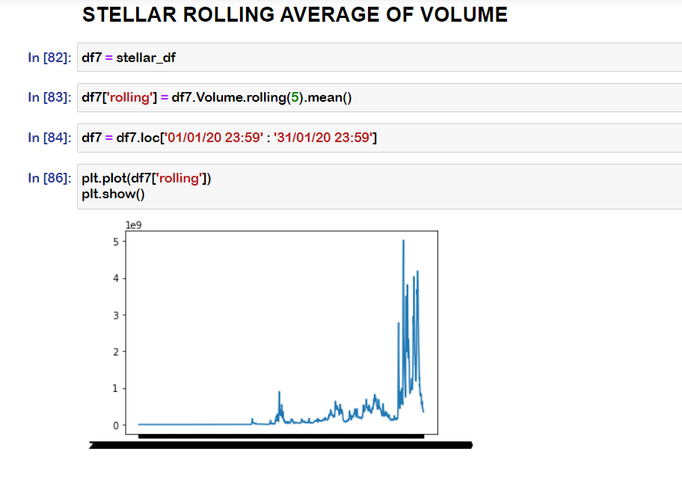
Plotting rolling average of volume of Stellar

Slide 12
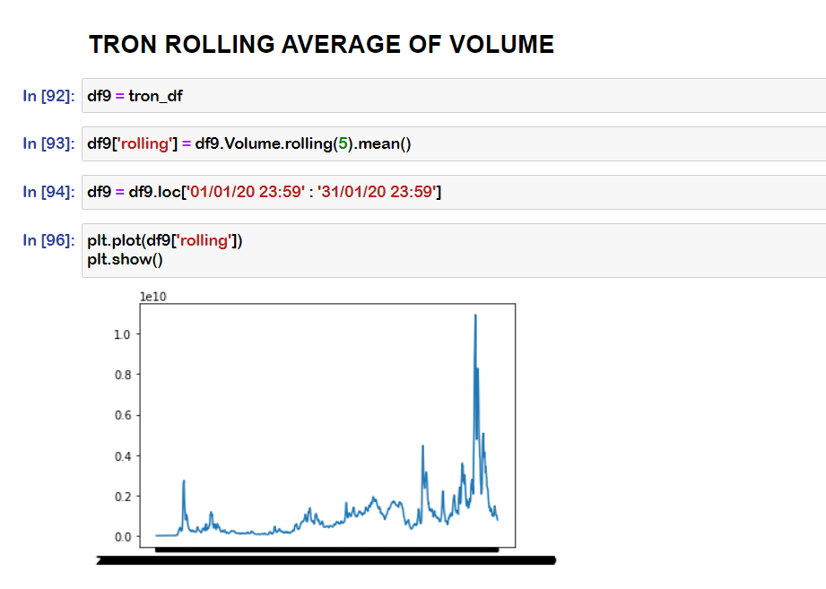
Plotting rolling average of volume of Tron

Slide 13
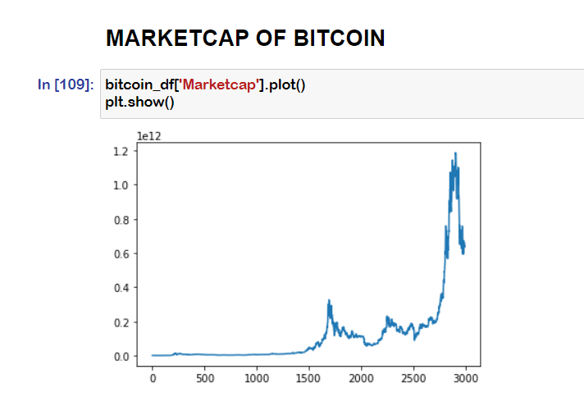
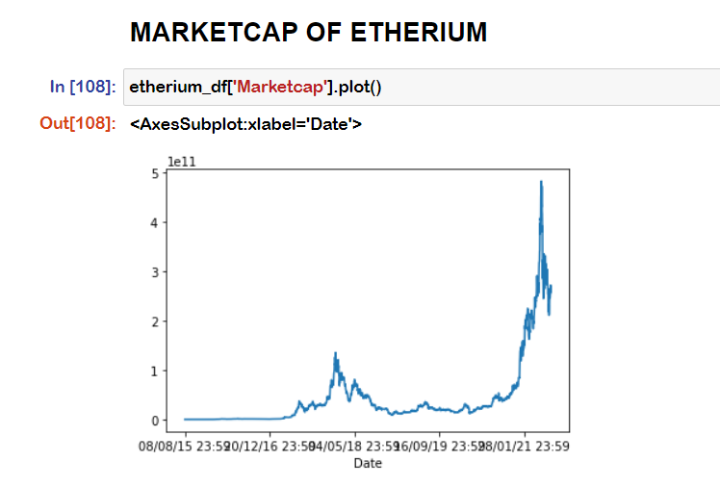
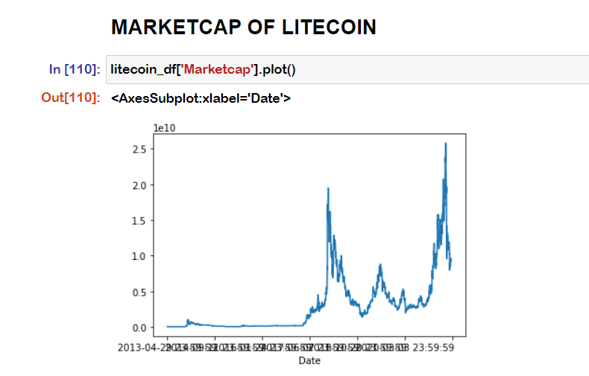
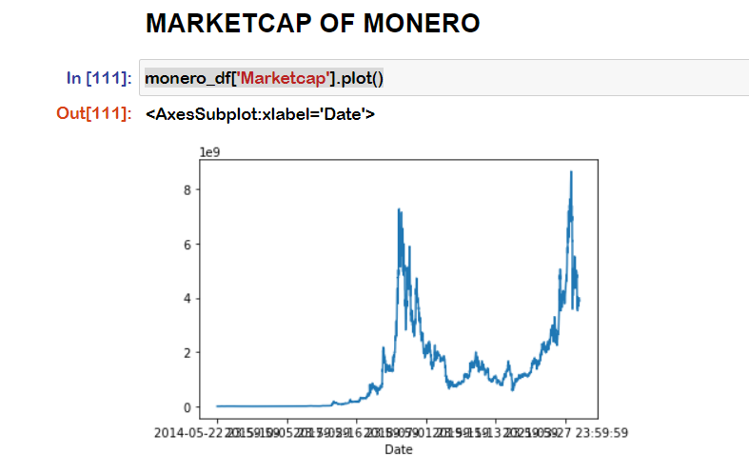
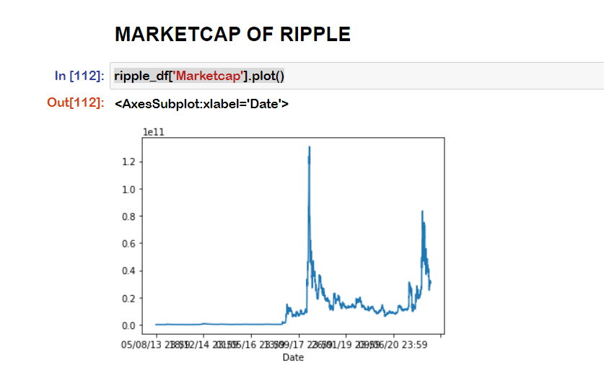
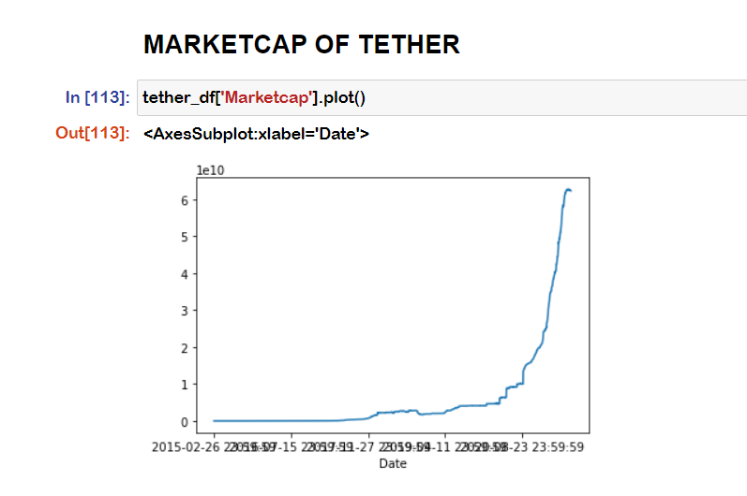
Marketcap of all coins

Slide 14
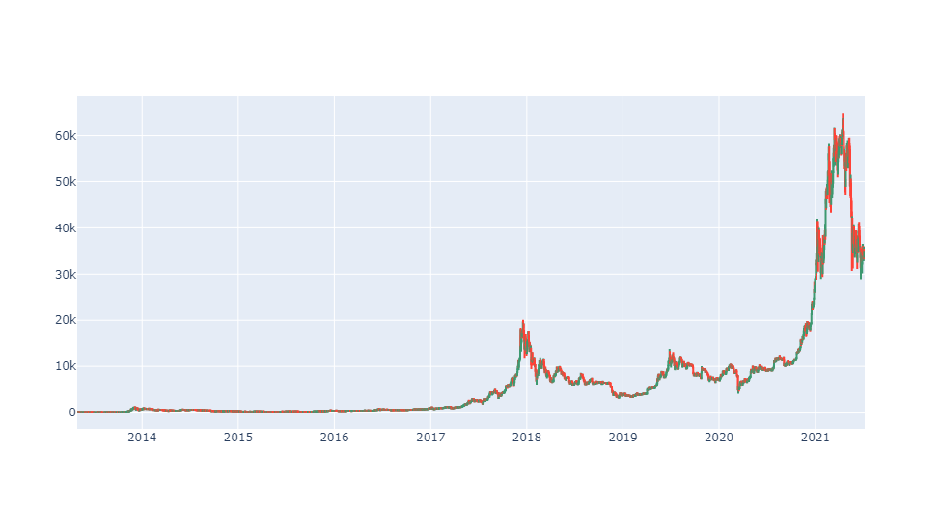
Candlestick chart of Bitcoin

Slide 15
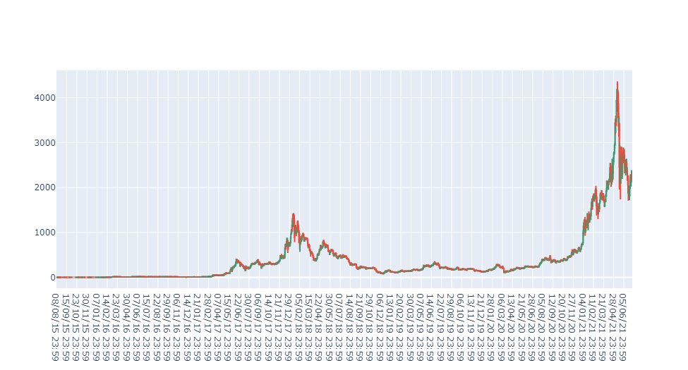
Candlestick chart of Etherium

Slide 16
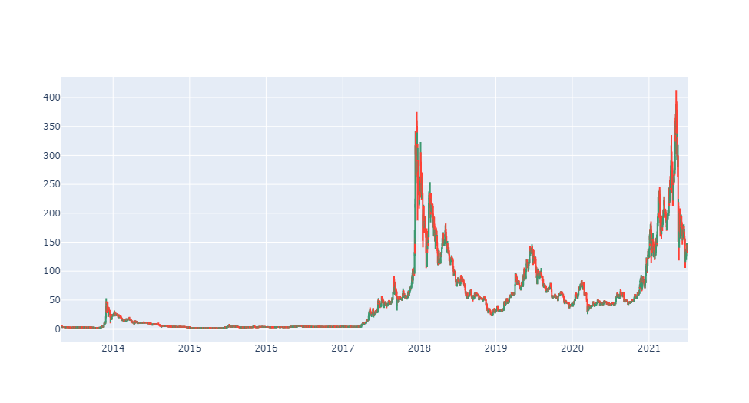
Candlestick chart of Litecoin

Slide 17
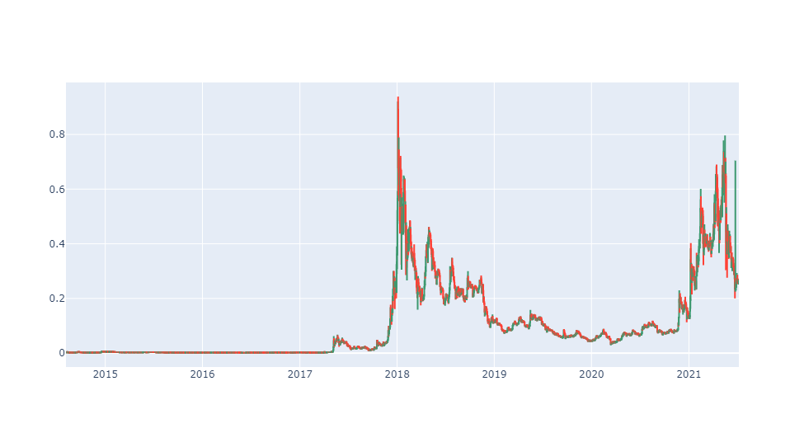
Candlestick chart of Stellar

Slide 18
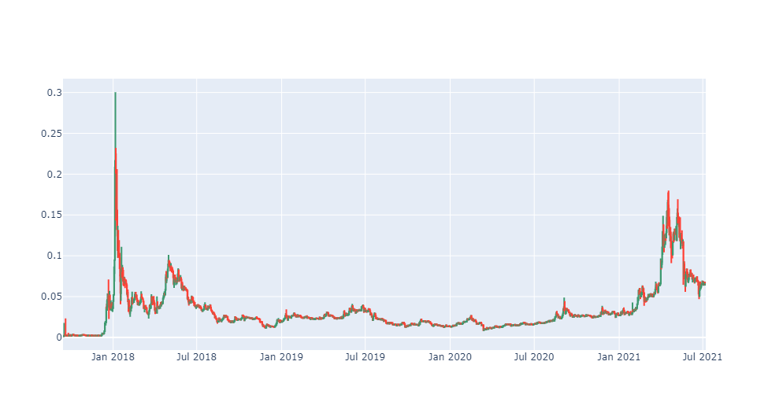
Candlestick chart of Tron

Slide 19
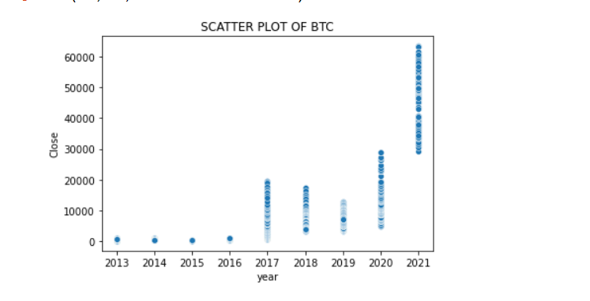
Scatter plot of BTC

Slide 20
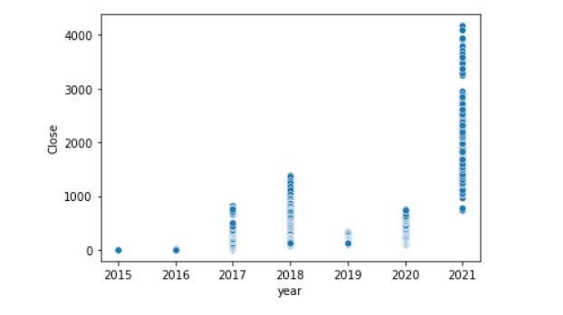
Scatter Plot of Etherium

Slide 21
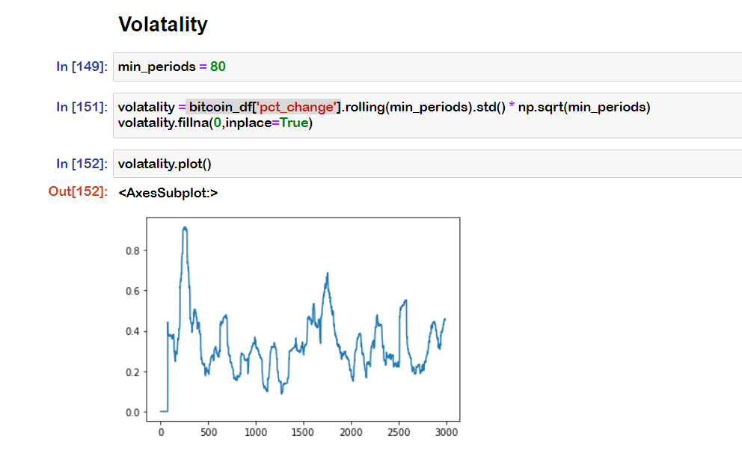
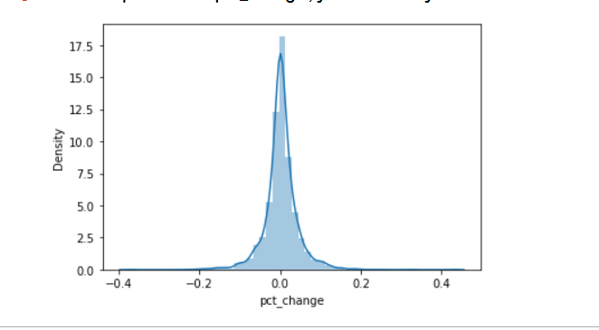
EDA OF BITCOIN

Slide 22
Conclusion

